Slide 1
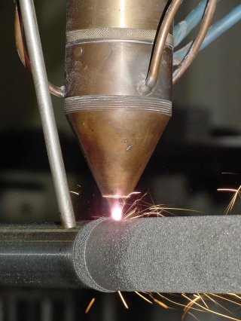
Laser Surface Alloying of Aluminium (AA1200) Alloy for Improving Hardness Property
Compiled by: Rambau Given
Supervisor: Dr Popoola A.P.I

Slide 2
Layout
Introduction
Laser surface alloying
Significance of study
Research methodology
Outcome
Conclusion and recommendations
Reference
Acknowledgement

Slide 3
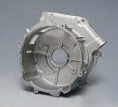
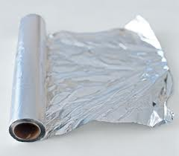
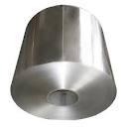
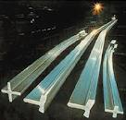
Introduction
Classification of aluminium alloys
Casting alloys- liquid material poured into moulds and solidify
Wrought alloys- about 85% is used in wrought products
Wrought products
Engine part
Foils
Rolled plates
Extrusions

Slide 4
Introduction, cont…
Further classification
Heat treatable- can be heated to achieve desired products
It depends on the alloying elements and its classification (2, 6 and 7xxx)
Non-heat treatable- their strength depends on elements in solid solution, particle and grain size.
It cannot be strengthened by heat treatment
Further increase in strength is done by cold working
Wrought alloys
1000-8000 series
1000 series are commercially pure~99% Al content
Other series are alloyed with
Magnesium, silicon, manganese, zinc and copper.

Slide 5
Introduction, cont…
AA1200 chemical analysis
Corrosion resistance
In atmospheric conditions
It is very active and forms oxide film
Properties
Highly reflective
Excellent thermal and electrical conductivity
Non-ferromagnetic
Element | Al | Fe | Si | Cu
Composition (wt%) | Balance | 0.59 | 0.13 | 0.12

Slide 6
Introduction, cont…
Applications of Al alloys
Automobile, aeronautical, marine applications and structural applications
Drawbacks
Aluminium is soft
Low hardness ±24 HV
Weak interatomic bonds
Stellite VI
Properties
Non-magnetic
Corrosion resistance
High hardness and toughness
Chemical analysis
Elements | Si | C | Fe | Ni | W | Cr | Co
Composition (wt%) | 1.o | 1.2 | 2.o | 2.0 | 4.5 | 29 | balance

Slide 7
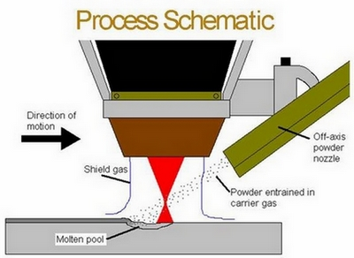
Laser surface alloying
Process description
Scanning with the laser beam
Deposition of powder particles
Solidification
Advantages
Selective process
High deposition rates
Low heat affected zone
Produces refined microstructures

Slide 8
Significance of study
Gap of knowledge
Increasing use of alloying elements for improving aluminium surface properties
Alloying elements in binary or unary form are used
Alloying elements such as Ni, Cr, SiC, Cu, Ti, etc.
These alloying elements has shown an increase in surface properties
Still a gap in using a combination of stellite 6 (Co-Cr base alloy) reinforce material.
Main objectives
Increasing the hardness of AA1200 alloy
Evaluating the newly formed microstructure
Hardness test.

Slide 9
Research methodology
Rofin Sinar Nd:YAG laser
AA1200 plate
Stellite 6
100 x 100 x 6 mm
Co-Cr base alloy
Sandblasting
Argon gas
Nd:YAG Optical fiber
KUKA robot arm
Powder feed tube
Laser processing head
Off-axis nozzle
Aluminium sample

Slide 10
Research methodology, cont…
Sample | Scan speed | Beam diameter | Power | Powder flow | Shield gas flow
AS-1 | 1.0 m/min | 3 mm | 3 kW | 3 g/min | 2 ℓ/min
AS-2 | 1.2 m/min | 3 mm | 3 kW | 3 g/min | 2 ℓ/min
AS-3 | 1.0 m/min | 3 mm | 4 kW | 3 g/min | 2 ℓ/min
AS-4 | 1.2 m/min | 3 mm | 4 kW | 3 g/min | 2 ℓ/min
Sample preparation
Ground down SiC 320-1200 grit size
Cloths (9, 3 and 0,04 µm)
Material characterization
Hardness testing
Vicker’s hardness tester
Load 100 g
Spacing 150 µm
Dwelling time of 15 seconds.

Slide 11
Outcomes
AS-1 780 AS-2 529 AS-3 707 AS-4 443

Slide 12
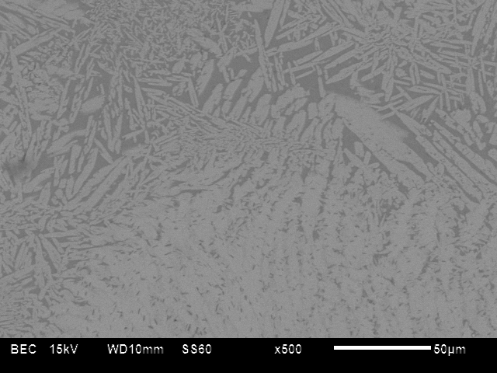
Outcome, cont…
Needle-like structures
Dendrites

Slide 13
Conclusion and recommendations
Conclusion
Power of 3 kW resulted in good metallurgical bonding of the newly formed matrix with the base metal and improved hardness property.
The power of 4 kW resulted in cracks along the interface of the laser alloyed matrix, but with improved hardness property.
A speed of 1.2 m/min resulted in low hardness and a speed of 1.0 m/min resulted in high hardness.
Recommendations
It is recommended to use a power of 3 kW for laser alloying of aluminium with stellite-6 powder to obtain an improved hardness property.
It is also recommended to use a speed of 1.0 m/min to yield high hardness property.

Slide 14
References
[1] Mabhali L A B, Pityana S L, Sacks N 2010 Laser Surface Alloying of Aluminium (AA1200) with Ni and SiC powders, Materials and Manufacturing Process, pp 1397-1403.
[2] Popoola A P I, Pityana S, Ogunmuyiwa E 2011 Microstructure and Wear Behaviour of Al/TiB₂ Metal Matrix Composites, Southern African Institute of Mining and Metallurgy, pp 120-8.
[3] Ready J F 1997 Industrial Application of Lasers, Academic Press, pp 380-2.
[4] Narendra B D 1998 Laser in Surface Engineering, ASM Int, pp121-138.
[5] Mabhali L A B, Pityana S L, Sacks N 2010 Laser Surface Alloying of Al with Mixed Ni, Ti and SiC powders, PICALO, Shangri-La Hotel Wuhan, Peoples Republic of China, pp 1-6.
[6] Popoola A P I, Pityana S L, Popoola O M 2011 Inter. J. Electrochem. Sci. pp 5038-51.
[7] Mabhali L A B, Pityana S L, Sacks N 2012 Laser Surface Alloying of AA1200, Mol. Cryst. and Liq. Cryst. pp 138-148.
[8] Luxon J T, Parker D E 1985 Industrial Lasers and their Applications, Prentice-Hall and Engineering. pp 248.
[9] Crafter R C, Oakley P J 1993 Laser Processing in Manufacturing, Chapman and Hall, pp 292.

Slide 15
Acknowledgements
I acknowledge the Council for Scientific and Industrial Research (CSIR) (NLC) rental pool for the laser facility.
The PISA supporting me throughout the experimental learning and then B-tech
I extend my gratitude to my supervisor Dr A.P.I. Popoola for guidance.

Slide 16
Thank you

