Slide 1
The African School of Fundamental Physics and its Applications
Kétévi A. Assamagan
Brookhaven National Laboratory
And University of Johannesburg

Slide 2
The First African School of Fundamental Physics and Its Applications – ASP2010 http://africanschoolofphysics.web.cern.ch/

Slide 3
ASP2010
Motivation
Contribute to capacity building in Africa
Instill the capacity to harvest, interpret and exploit results from physics experiments
Increase proficiency in related applications and technologies
Use the LHC and its experiments as an example, although the broader objectives are far beyond
We believe that the knowledge that the students gain will benefit them whichever careers they may pursue
Student Participation
65 students, mainly from Africa, a few from abroad
Lectures
Theoretical Particle Physics (first week)
Experimental Particle Physics (second week)
Applications: medical physics, accelerators, technologies (third week)
Grid computing, Geant-4 simulation, data analysis
Lecturers
A number of excellent lecturers some of whom are in this audience
Financial support
By 15 institutes from Africa, Europe and the US. The largest support came from the Spanish Ministry of Foreign Affairs

Slide 4
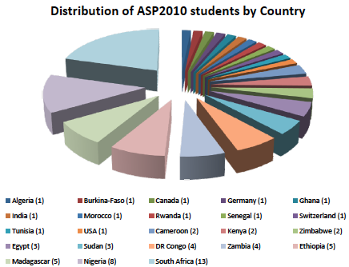
ASP2010 – Students

Slide 5
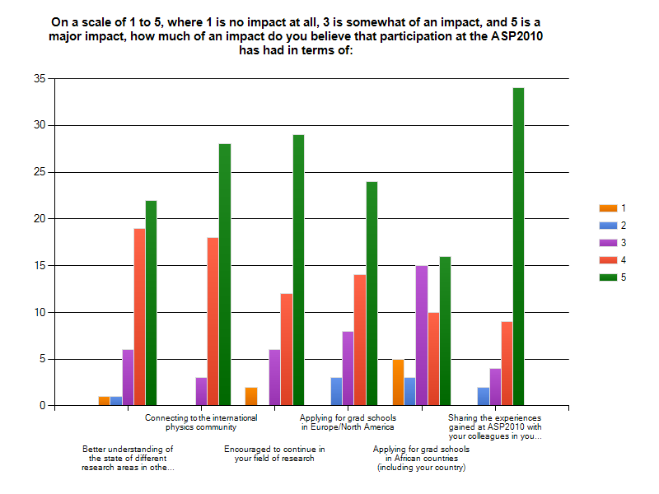
ASP2010- Student Feedback

Slide 6
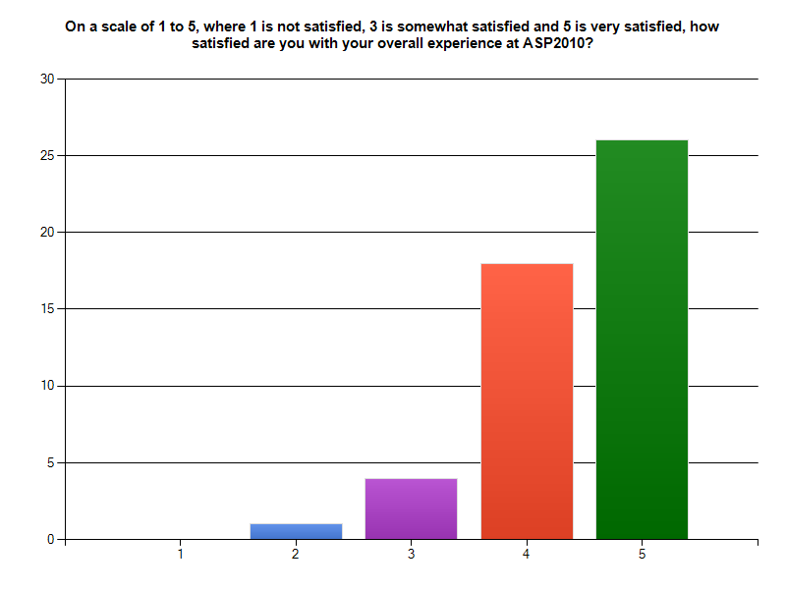
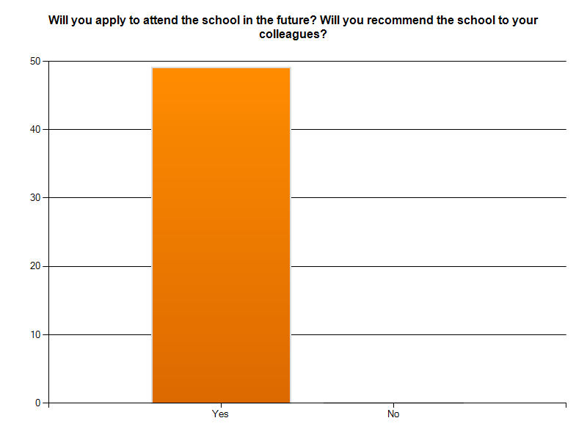
ASP2010 – Student Feedback

Slide 7
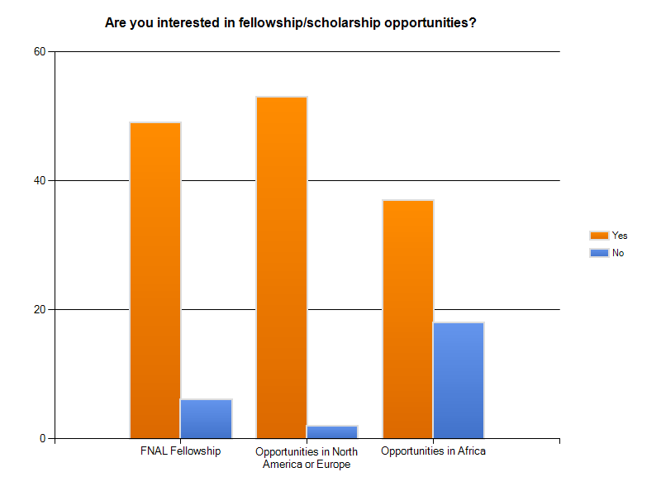
ASP2010 – Student Feedback

Slide 8
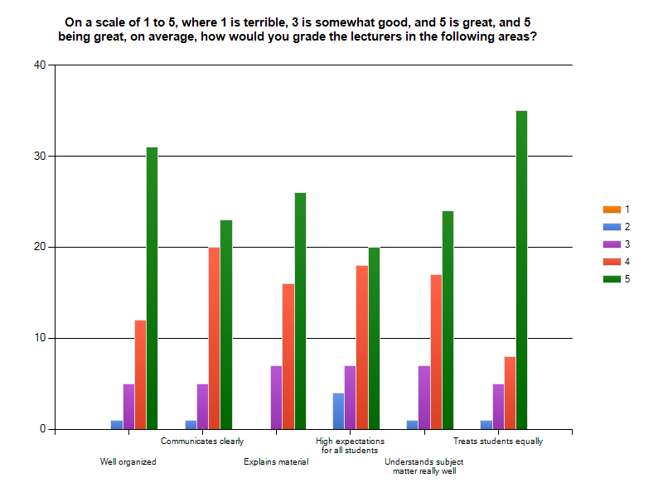
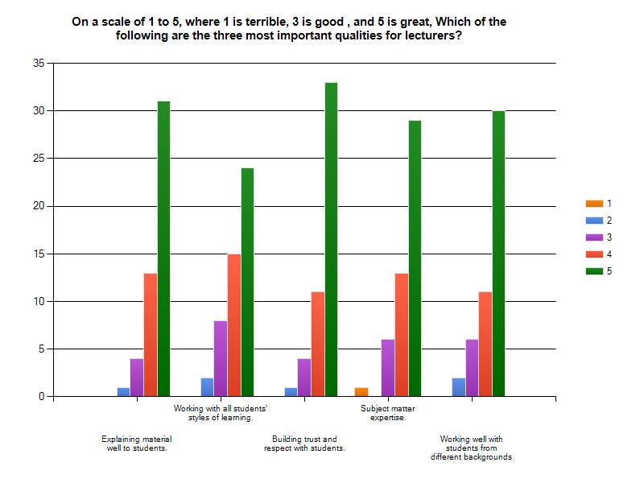
ASP2010 – Student Feedback

Slide 9
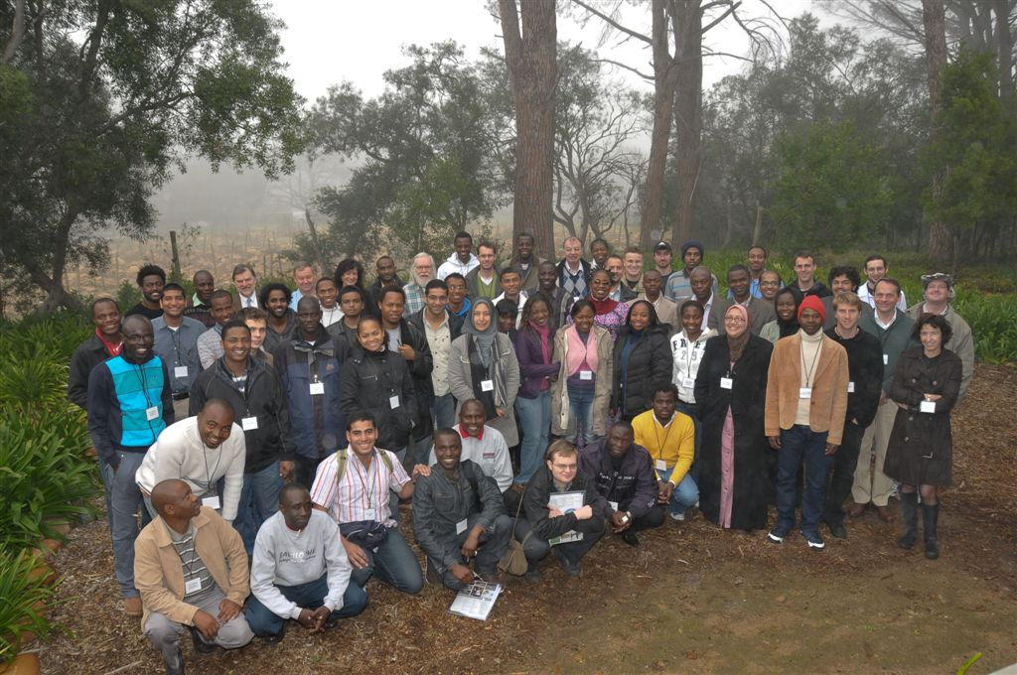
African School of Fundamental Physics, 1-21 August 2010, Stellenbosch, SA

Slide 10
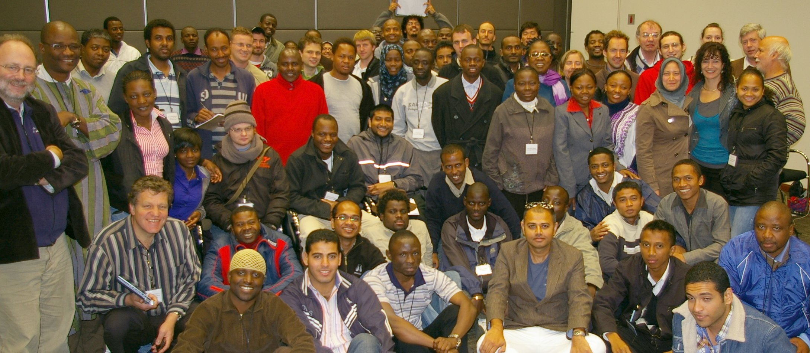
African School of Fundamental Physics, 1-21 August 2010, Stellenbosch, SA

Slide 11
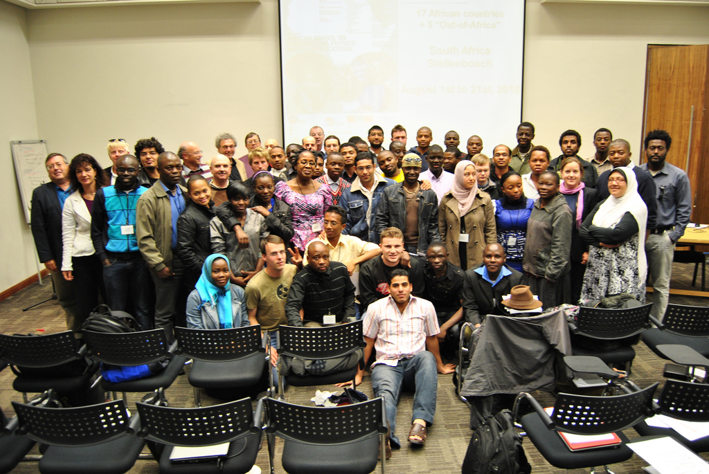
African School of Fundamental Physics, 1-21 August 2010, Stellenbosch, SA

Slide 12
Outlook
By all accounts, ASP2010 was a very position experience towards our broader objectives
Based on feedback from the participants
But the impact of APS2010 is limited in scope
3 week courses
65 students
Hardly enough to make a significant difference
Therefore need to organize this school periodically
Next one in 2012
Rotating in different African countries
July 15 – August 8, 2012: ASP2012 in Ghana

Slide 13
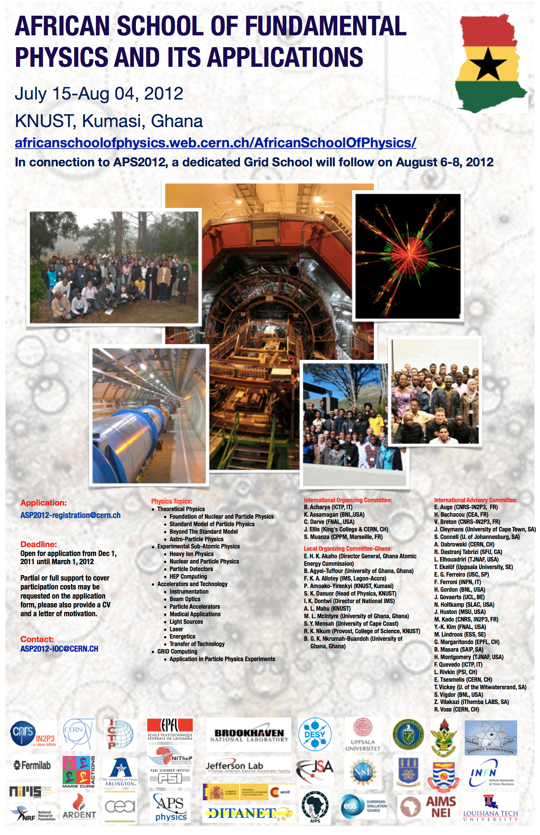
ASP2012
The donors

Slide 14
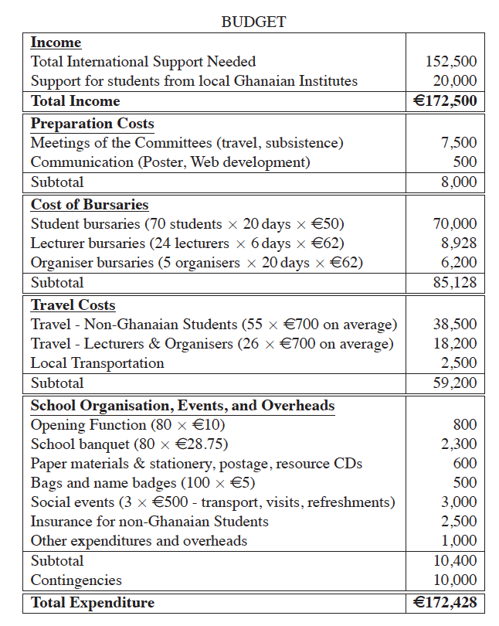
ASP2012

Slide 15
ASP2012
http://africanschoolofphysics.web.cern.ch/AfricanSchoolofPhysics/
We received 132 applications
Of which we selected 60 students
6 of them dropped out. 54 students from 17 countries will attend APS2012
ASP2012 will take place at the Kwame Nkrumah University of Science and Technology (KNUST) in Kumasi Ghana
ASP2012 starts on July 15. All the arrangements are made
We’ve collected enough funds to match the budget

Slide 16
ASP2012 Students by nationality

Slide 17
ASP2012 students by age

Slide 18
Conclusions
ASP2012 starts at KNUST, Kumasi Ghana. July 15 – August 8, 2012
54 students for 17 countries
ASP2012 builds up on the success of ASP2010
The budget has been secured. Special thanks to all the donors

