Slide 1
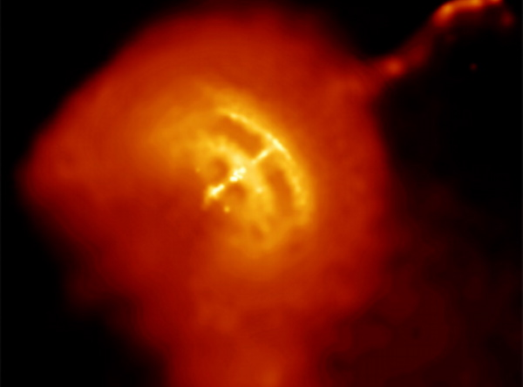
Modelling of non-thermal radiation from pulsar wind nebulae
Joshua L. Botha
B.Sc. Hons.
11-07-2012

Slide 2
Outline
Short introduction on non-thermal radiation mechanisms of pulsar wind nebulae
Workings of mathematical model used
Results of model application on one known source and one unknown source
Conclusions drawn from model

Slide 3
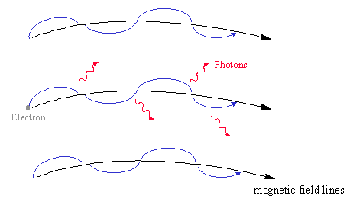
Synchrotron radiation
The angle between the direction of the magnetic field and the direction of the total velocity of a particle is called a pitch angle
The Lorentz force acts upon any charged particle moving in a magnetic field
The charged particle rotates around magnetic field line
The centripetal acceleration leads to the emission of photons
Typically in an astrophysical system the particle spectrum can be described by a power law

Slide 4
Synchrotron radiation
Assuming the pitch angle distribution is isotropic the synchrotron radiation is calculated by integrating over pitch angle as well as electron energy, leading to the following equation:

Slide 5
Inverse Compton radiation
Energetic particles can collide with photons
Collision causes the particle to lose energy, but the photon energy increases greatly
Sources of photons can be CMBR, IR photons, starlight, and sychrotron emissions

Slide 6
Pulsar wind nebulae
Pulsars are stellar remnants of supernova explosions
Due to the conservation of angular momentum of the parent star the produced pulsar has a high rotation energy
Rotation rate decreases over time, therefore the rotational energy must be converted into other forms
The two main energy conversions are magnetic dipole radiation and injection of relativistic electrons/positrons (supersonic pulsar wind) into surrounding medium

Slide 7
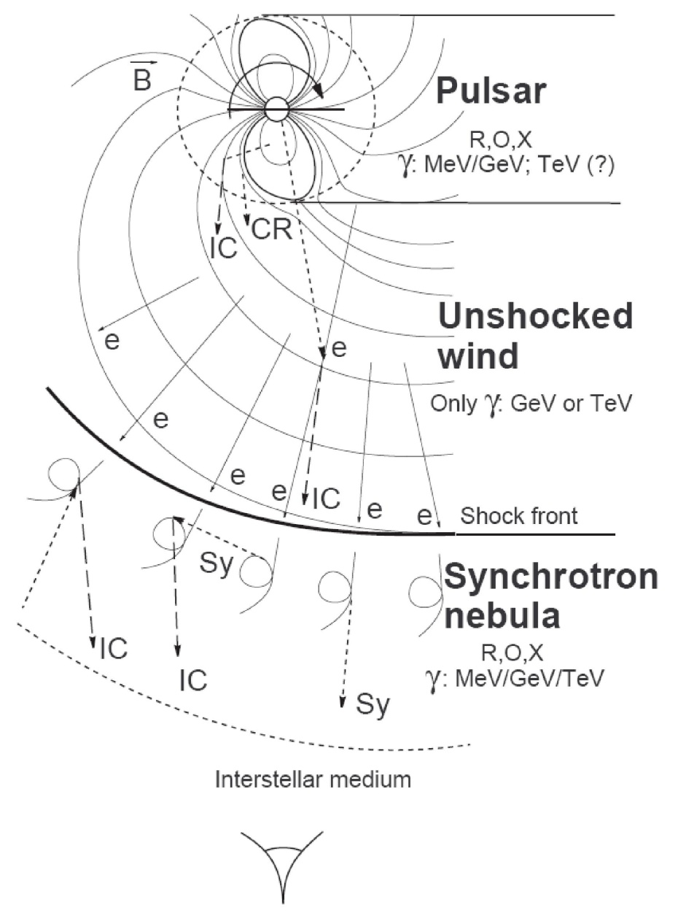
Pulsar wind nebulae
Due to the conservation of magnetic flux the pulsars magnetic field is frozen into and carried out by the pulsar wind
At a certain point the pressure of the injected pulsar wind is the same as the pressure of the surroundings, causing a termination shock after which the particles move at sub sonic speeds
The injected particles interact with the surrounding medium causing synchrotron and inverse Compton radiation

Slide 8
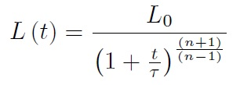
Model

Slide 9
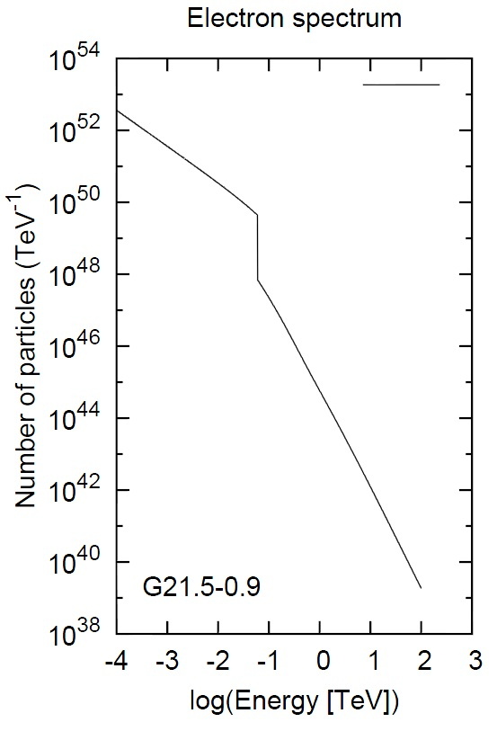
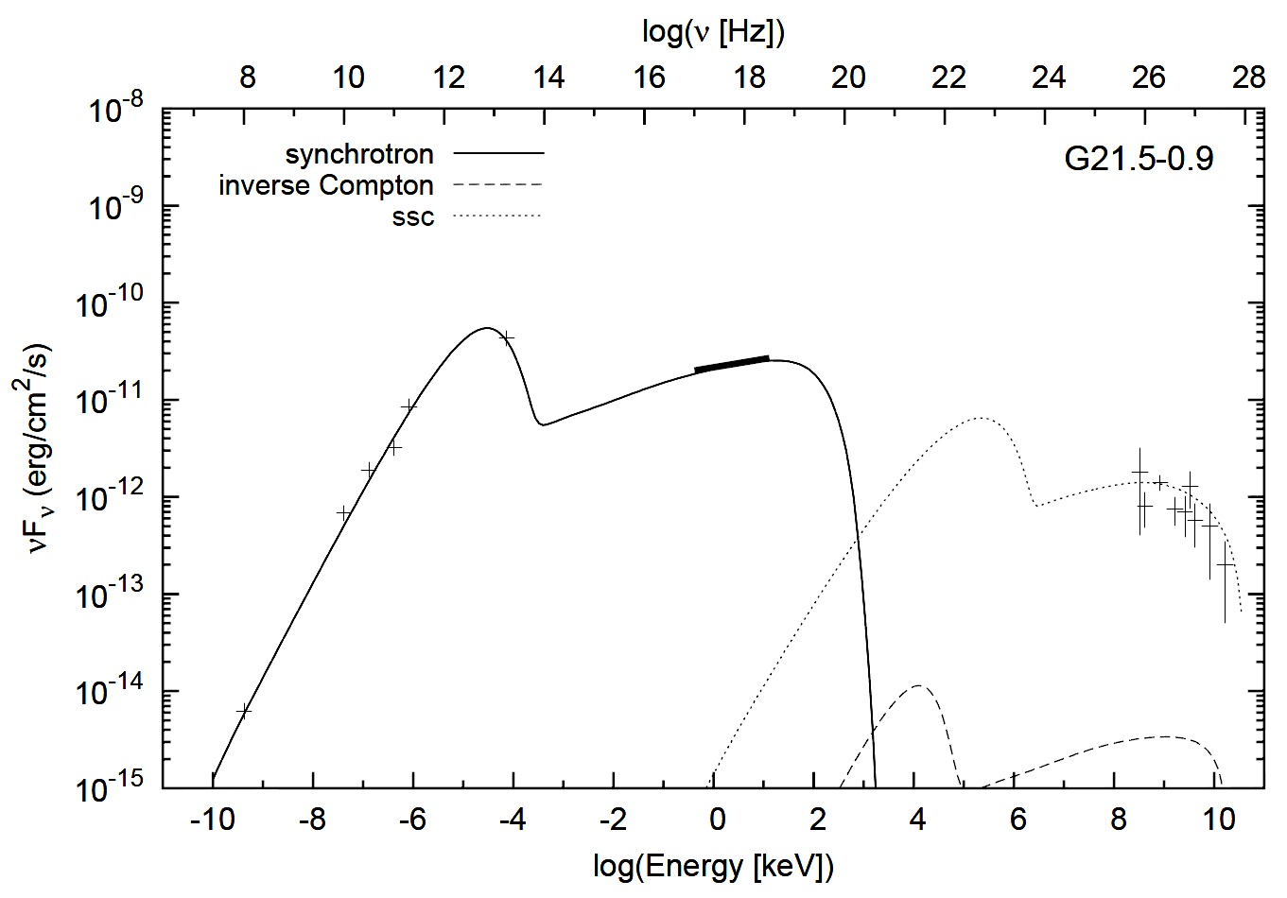
results
Some observed parameters | Some parameters used
B₀ = 1.3x10² μG L_{current} = 3.3x10³⁷ erg/s Distance = 4.6 kpc T_{age} = 4.8 kyrs | η_{R} = 0.3 η_{X} = 0.06 r₁ = 1.4 pc r₂ = 0.2 pc
The model predicted a current magnetic field strength of 250 μG, where the observed strength is 300 μG.

Slide 10
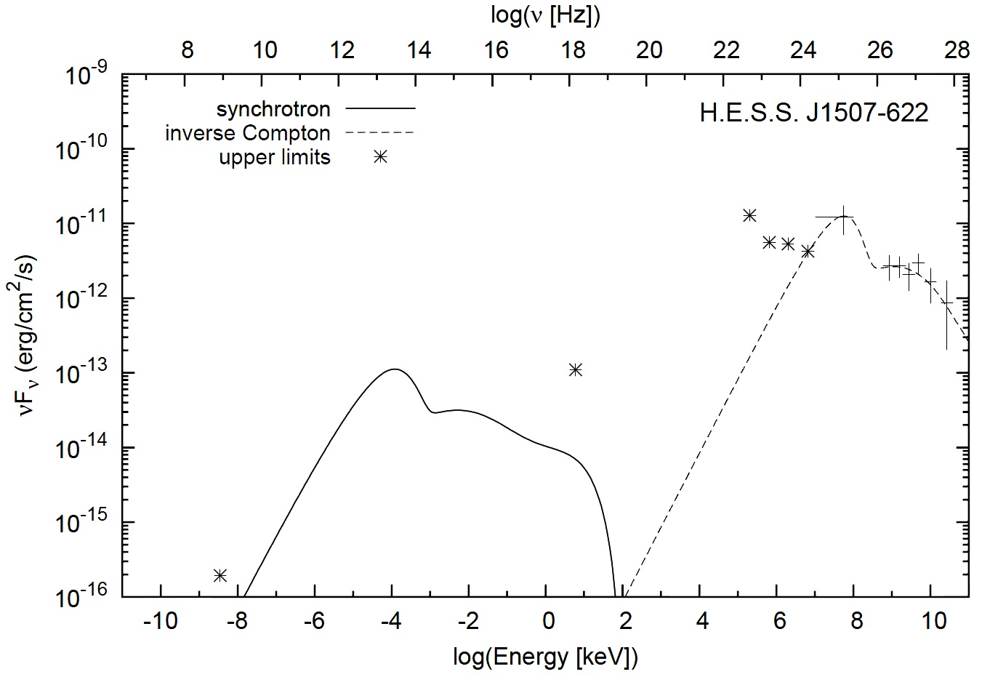
results
Known: further than 6 kpc.
Parameters used: distance = 6 kpc, T_{age} = 15 kyrs,
L₀ = 1.5x10³⁹ erg/s, η_{R} = 0.2, η_{X} = 0.05, τ = 6 kyrs.
Predicted B = 0.3 μG.

Slide 11
conclusion
The model can be used to obtain first-order estimate
A dual electron energy population is not necessarily a result of the long term pulsar evolution (as often stated)
The predicted magnetic field strength for an old PWN is less than the cosmic background magnetic field strength
η_{R} seems to be a factor 10 larger than η_{X}.

